Slide 1
Power of Network
Apple,Amazon ,Google ,Tesla,Facebook
and WhatsApp Operates on this concept.

Slide 2
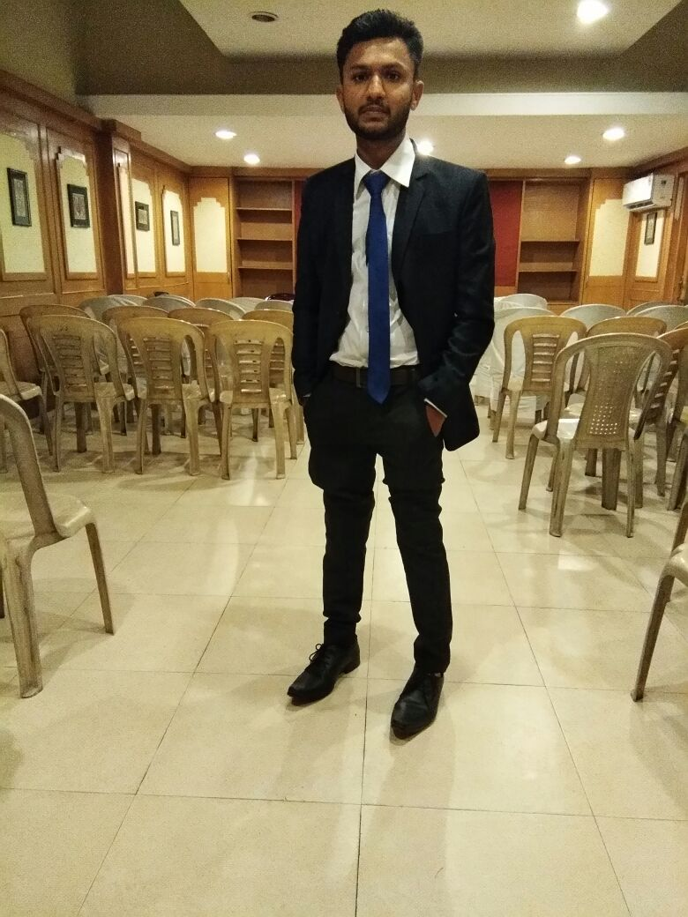


Time
Mr. UDIT CHAWLA
MR SRIDHAR NAIK
KIET GHAZIABAD
TEAM=65000
ACTIVE=2000
2000….* 1 HRS =2000HRS
Nit Jamshedpur
Team=200
Active=50
50….* 1
HRS =50 HRS

Slide 3



MONEY
MR SIDHHARTH VIKRAM SINGH
Mr prajwal sir
Nit warangal
TEAM=3500
ACTIVE=200
200….* 1 people
=200 new people
orbit=200/50=4
Income=1 lacs
KIET GHAZIABAD TEAM=100000
ACTIVE=3000
2000….* 1 people =2000 new people
orbit=2000/50=40
income=40*25000=
10 lacs

Slide 4
Same degree | Same degree
8 to 10 hrs | 100 hrs 200 hrs 2000hrs
5 lacs per annum | 1 lacs or 2 lacs or 5 lacs per Months
10 lacs per annum | 10 lacs per months
X
Y

Slide 5

Millionairship
Its Sad to listen that an average human is not able to earn the 1 crores……..working whole life…..
salary=50000
rent=15000
food=5000
Parents =10000
others=00.00
saving=20000
per month
1 year saving=2.5 lacs
30years=2.5*30
75lacx
Marriage education
Child care home car
All expenditure….
If 1 crore at the age of 24 or 25
years of age bank offers interest of 7.5%……

Slide 6

Some legend earn 1 crore in 1 year sir….
In 1 month…. 1 day …sir….but how sir?
Kaun banega krorpati..
Rajeev metro delhi
Middle class life

Slide 7




Company profit=80000
salary=40000
1200 crores
3 lacs workers
400 Crores
Millions people
5th richest person of the world
1.5 billions

Slide 8
No people
No earning
No people
No earning
No people
No earning

Slide 9
Navjot
Singh
Sidhhu

Slide 10
Power and money under the table
3-5 years
70000 per
month
18 hrs of study
Little Security
100000 per
month
3-5 years
No Security
Ebiz
1 crore
Passive income
Team of leaders
3-5 years
Security

Slide 11
Tech Life | Tech life + ebiz
4years and 8-10 lacs…… | 8-10 lacs + 16821= 10 laxs..
Theoretical knowledge | Real life education
Definition of skills | Skills practice on daily basis….
Exams and mugging up… | Communication skill
Skills of employee… | Presentation skill
Last minute preparation attitude | Convincing skill How handle failures….
Whatsapp facebook …. | Confidence and personality development
Lot of distractions | Skills of an entrepreneur …
5% skills ‘….without any security | 95% skill along with security….

Slide 12




Support system

Slide 13
Cola..2 | Cola..2222222Cola..2Cola..2
Manufacturer profit…2 | NO MIDDLEMAN
Retailer consumer wholesales..3 | MANUFACTURER TO CUSTOMER
Transportation costs..1 | NO MEDIA NO STARS
GST …2 | CUSTOMER IS PROMOTER
ADVERTISMENT….4 | SO THE COST IS BACK TO CUSTOMER
MEDIA TV STARS…2
Traditional Marketing
Network Marketing

